Slide 1
END SEMESTER PROJECT Mathematics For Computing - II
THREAD ART PORTRAIT
A presentation by project group 17

Slide 2
01
INTRO DUCTION
What/ How/ Why are we going to do?

Slide 3
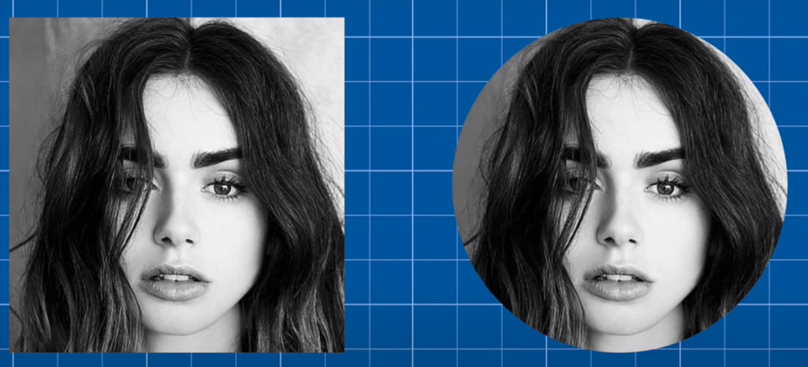
Thread art portrait using SVD
Initialization

Slide 4
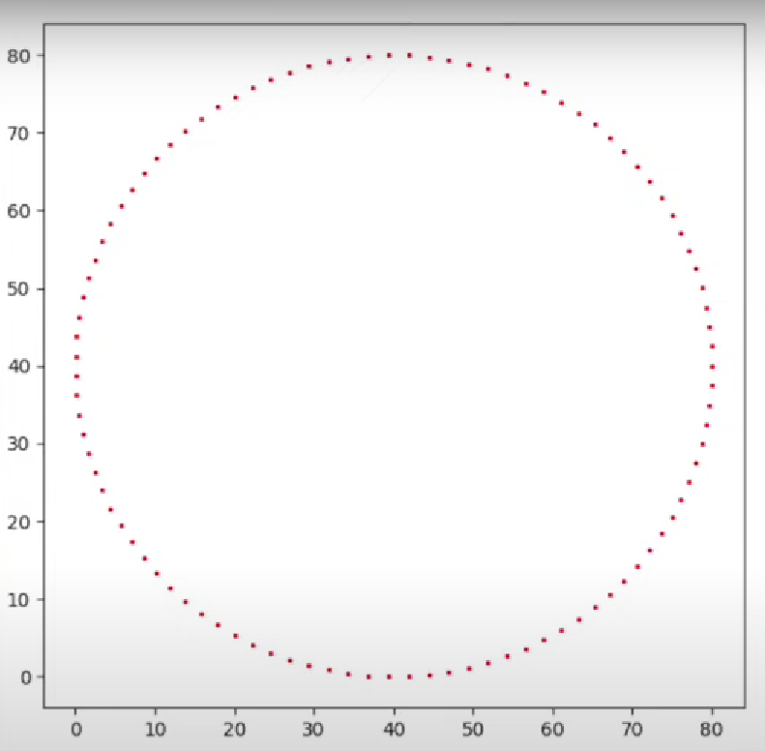
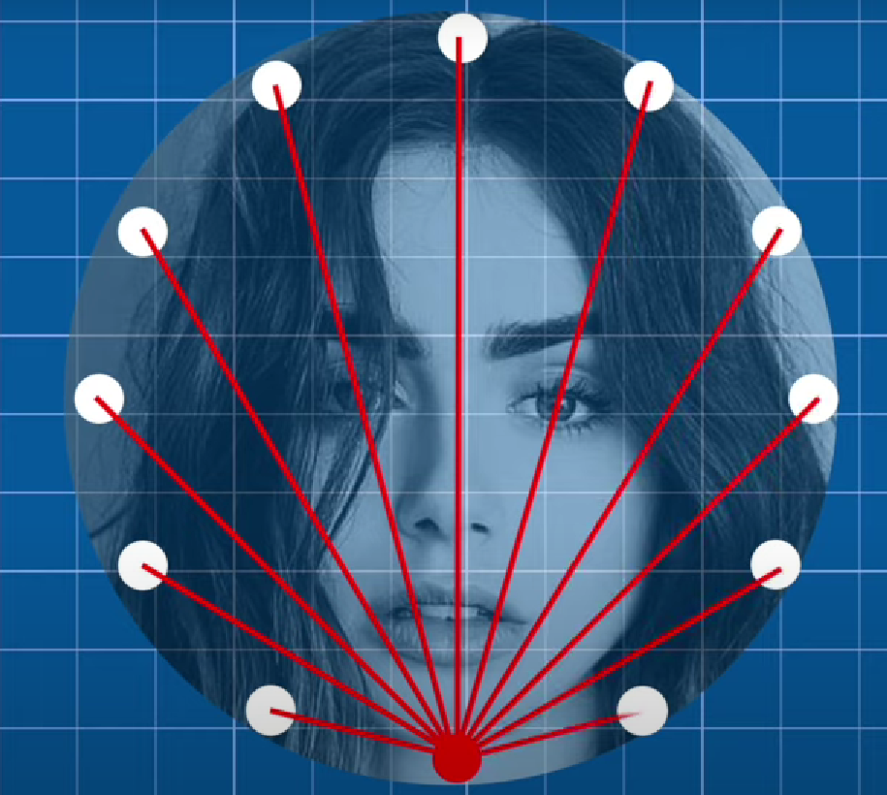
Thread art portrait using SVD
More initialization

Slide 5
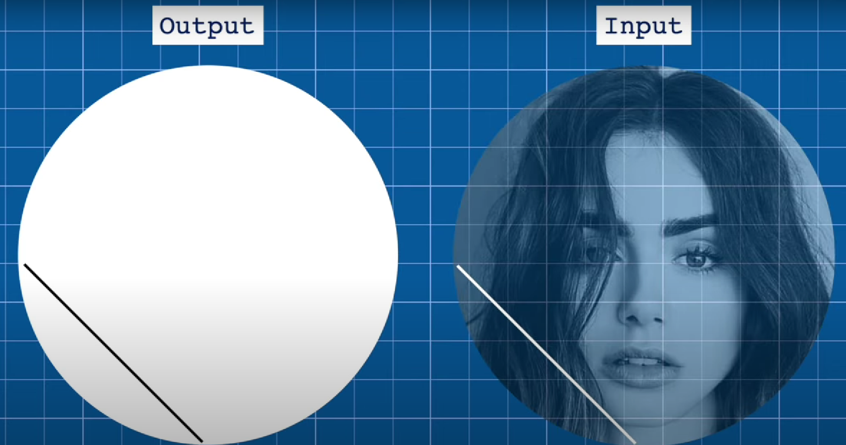
Thread art portrait using SVD
More initialization

Slide 6
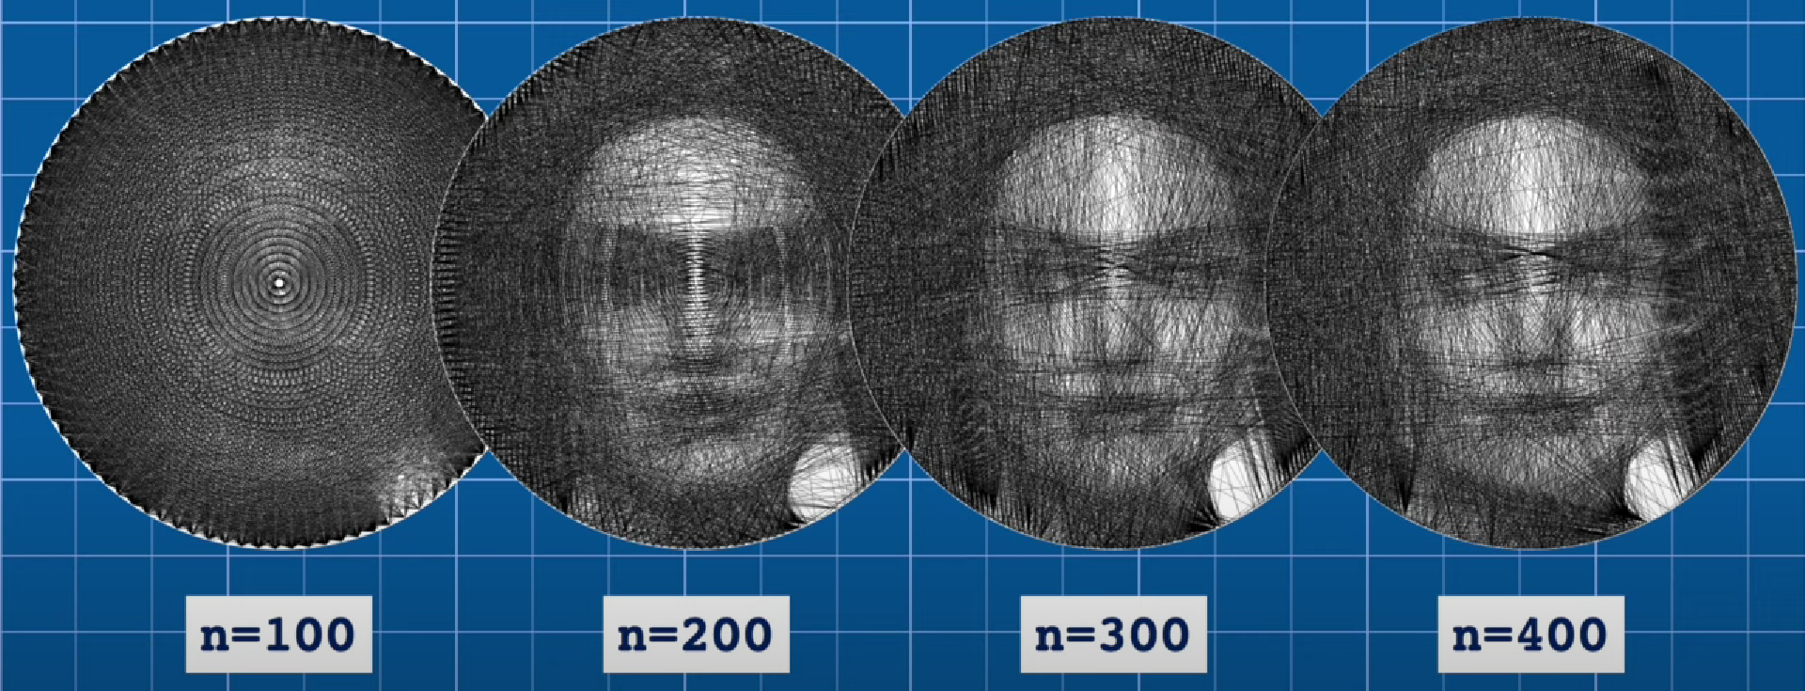
Thread art portrait using SVD
Variation due to number of pins

Slide 7
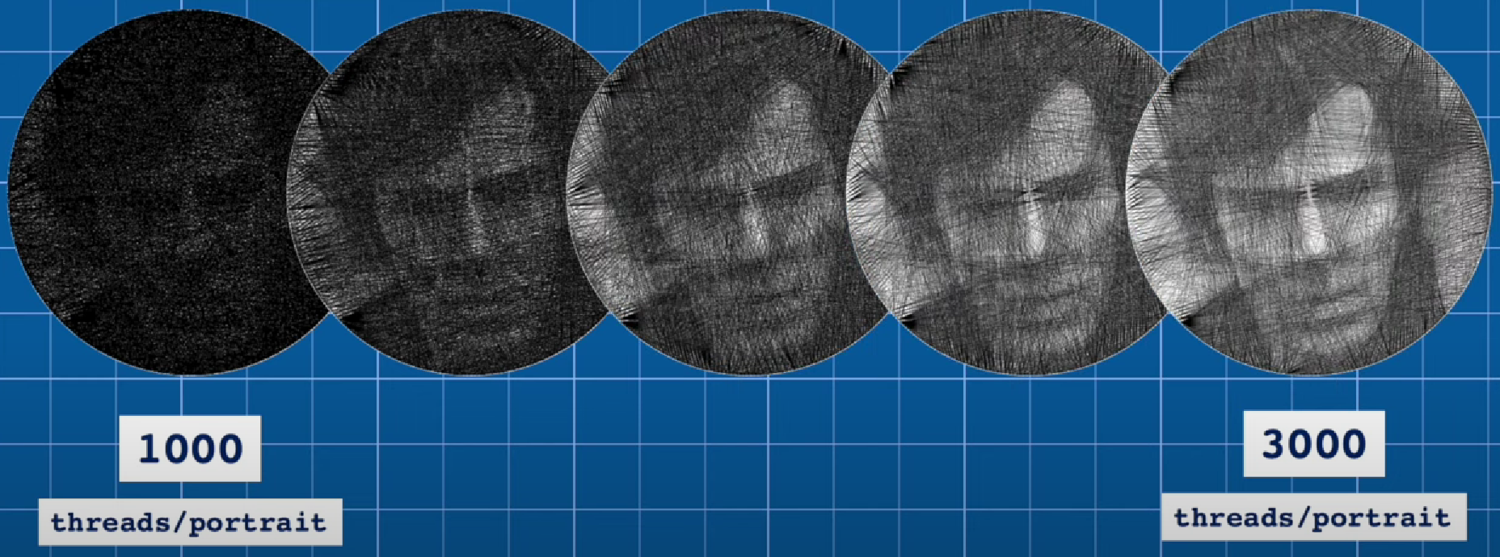
Thread art portrait using SVD
Variation due to number of connections

Slide 8
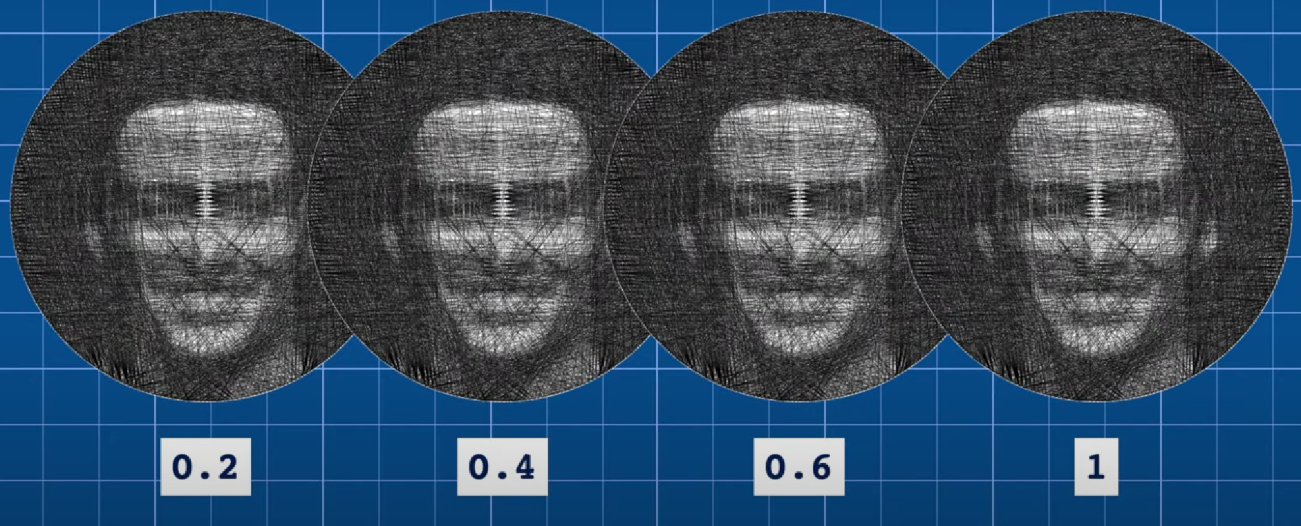
Thread art portrait using SVD
Variation due to line thickness

Slide 9
Thread art portrait using SVD
Variation due to line thickness

Slide 10
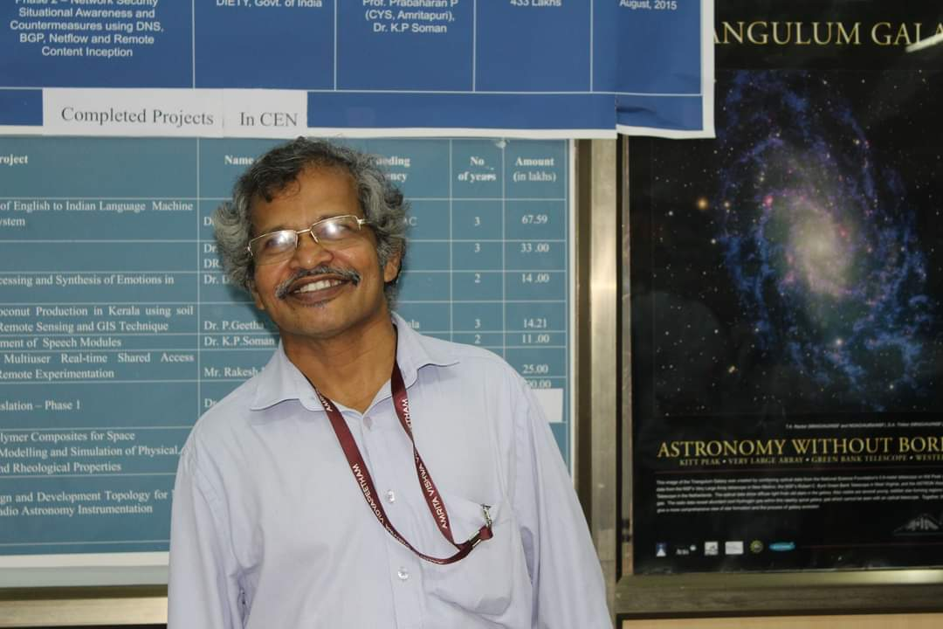
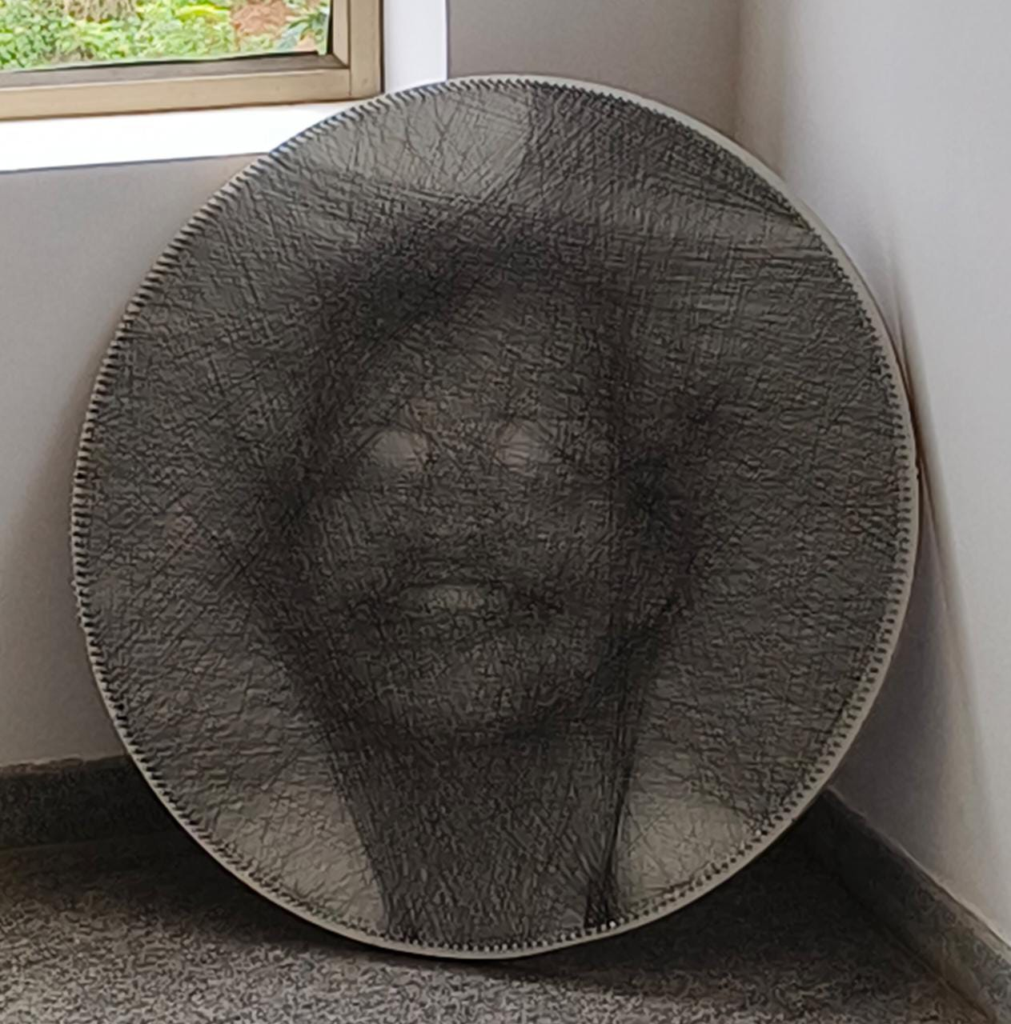
OUTPUT VERIFICATION
Input v/s Output : (in image Dr. K.P.Soman, HOD, CEN)

Slide 11
02
Chapter wise Implementation in MATLAB

Slide 12
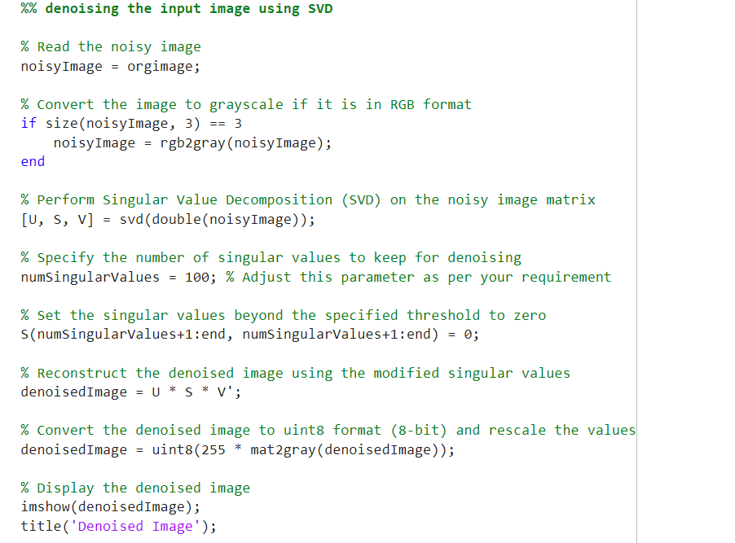
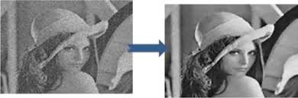
De noising the image using SVD

Slide 13
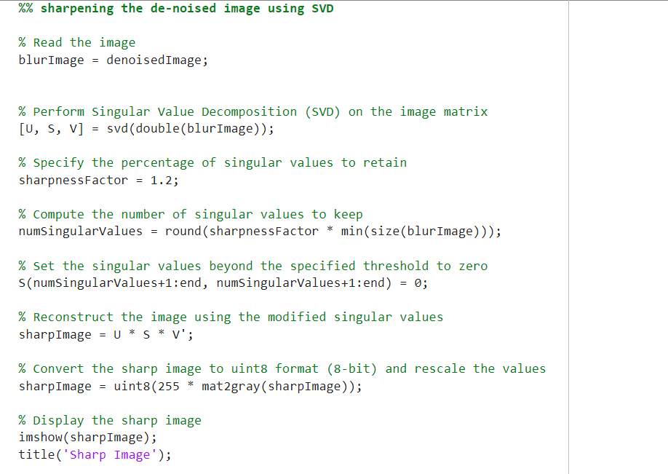
Sharpening the denoised image

Slide 14
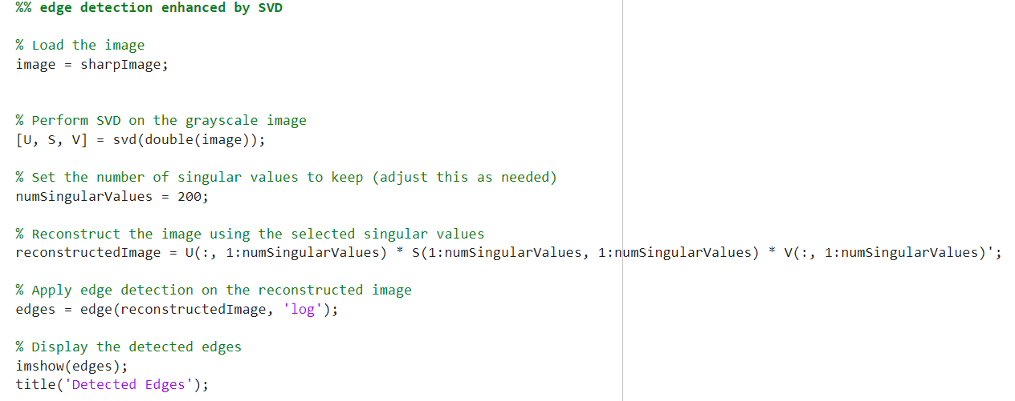
Edge detection enhance by SVD

Slide 15
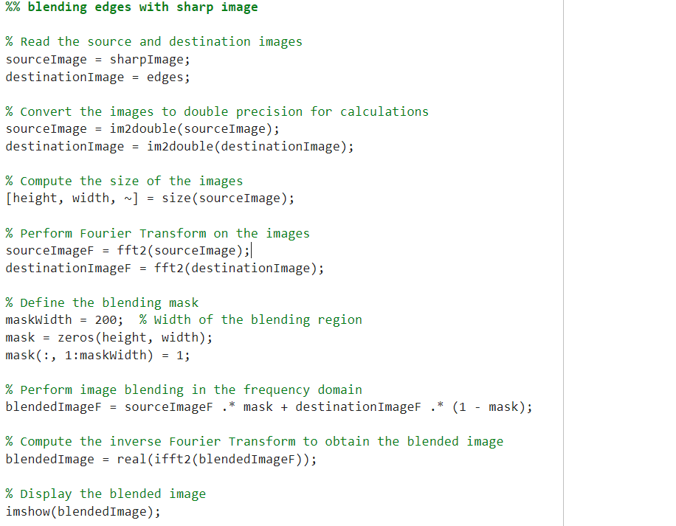
Blending edges with sharp image

Slide 16
03
Main Code

Slide 17
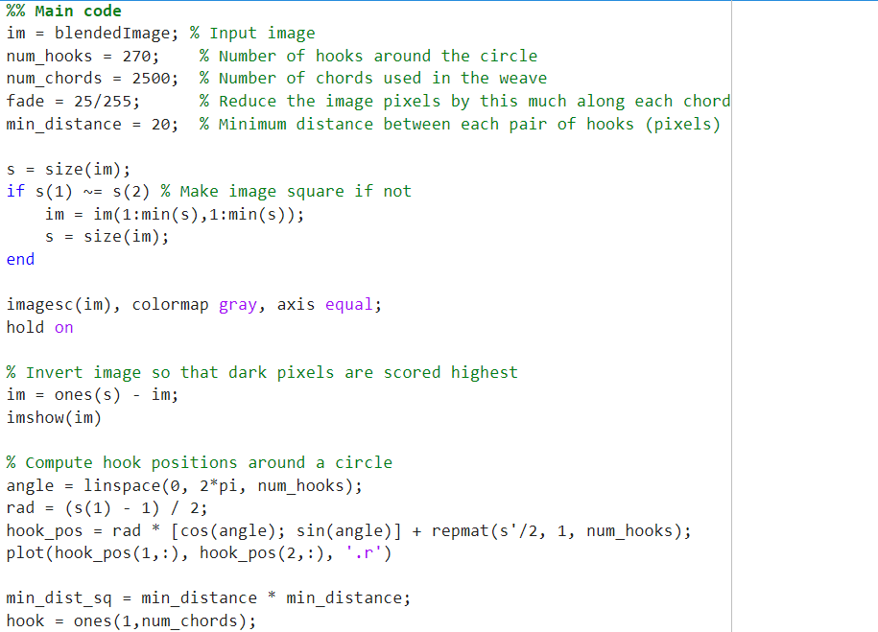
Logic implementation

Slide 18
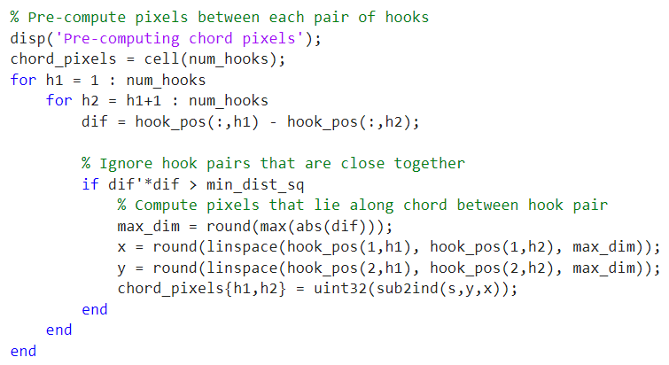
Logic implementation

Slide 19
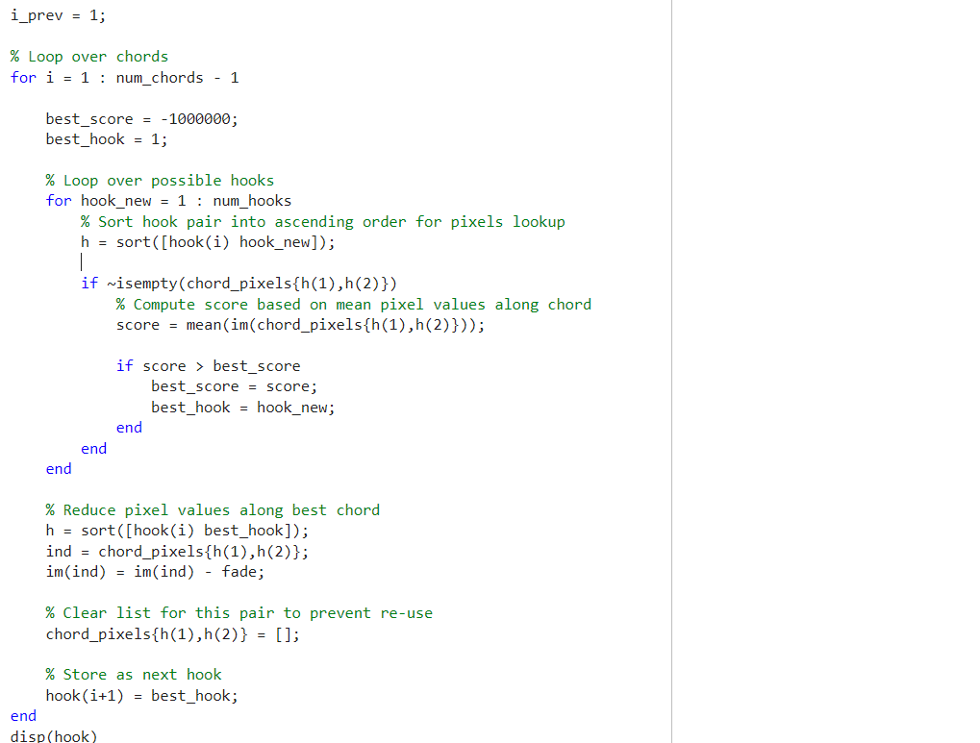
Logic implementation

Slide 20
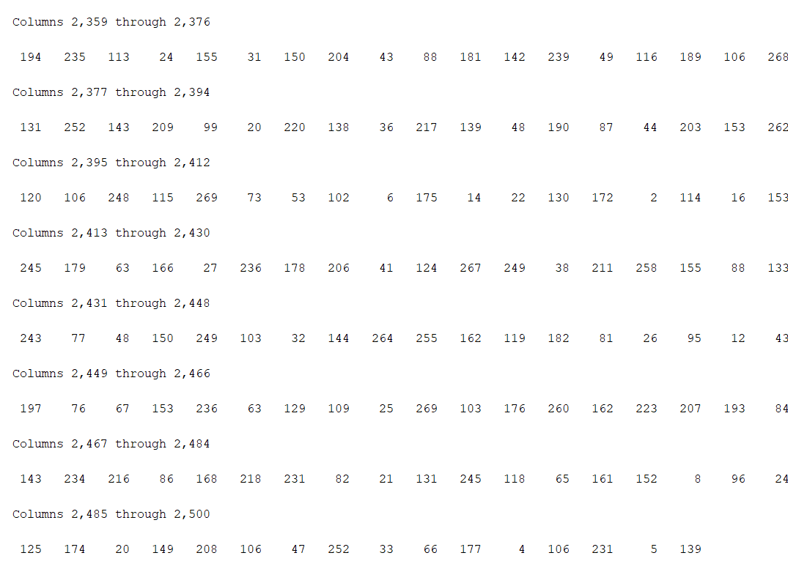
Code Output

Slide 21
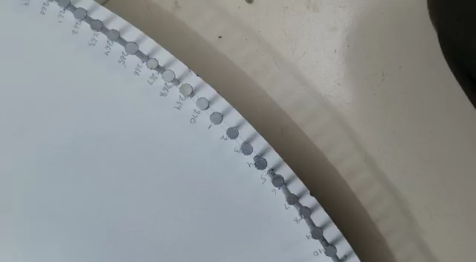
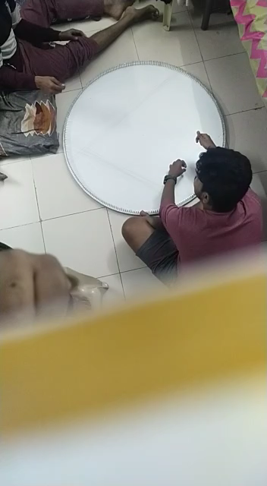
Building portrait

Slide 22

Thank You!
Batch B, TEAM 17

